Slide 1
Topics
PL/SQL review
Explicitly Raising an Exception
Functions
Triggers

Slide 2
PL/SQL Review
What are the different types of iteration statements?
Basic LOOP
FOR LOOP
Cursor FOR LOOP
WHILE LOOP
How can you leave a loop
EXIT
EXIT WHEN
What does Continue or Continue When do?

Slide 3
PL/SQL Review
What are the two types of cursors:
Implicit cursors
Explicit cursors
What is an implicit cursor?
The implicit cursors are automatically created while a statement such as INSERT, UPDATE, DELETE, and SELECT are executed.
The implicit cursor attributes can be used to determine if any rows have been affected as a result of the execution of a SQL statement.

Slide 4
PL/SQL Review
For an implicit cursor, what returns the number of rows affected by the execution of a DML statement or a SELECT statement
SQL%ROWCOUNT

Slide 5
PL/SQL Review
How are %Type and %RowType used
you do not have to know the definition of a column in a table when setting up your variable or the definition of an entire row of columns when setting up multiple variables.
if the type definition for that column or a row of column changes, your code does not have to be updated – it will automatically pick up the new type definition

Slide 6
PL/SQL Review
What are five steps involved when using an explicit cursor
DECLARE the cursor
OPEN the cursor
FETCH rows from the cursor
Do something with the fetched row
CLOSE the cursor

Slide 7
PL/SQL Review
How do you Define a Cursor?
CURSOR cursor_name IS select_statement;
OPEN cursor_name;
If you want to include parameters?
CURSOR cursor_name (parm1 parm1type,parm2 parm2type)
IS select_statement;
OPEN cursor_name(parm1value, parm2value);
How do you retrieve a row from your cursor?
Fetch cursor_name into variable list

Slide 8
PL/SQL Review
How do you employ a cursor without explicitly stating the open, close and fetch?
For VQ in cursor_name
LOOP
DBMS_OUTPUT.PUT_LINE(vq.col1, vq.col2)
END LOOP;

Slide 9
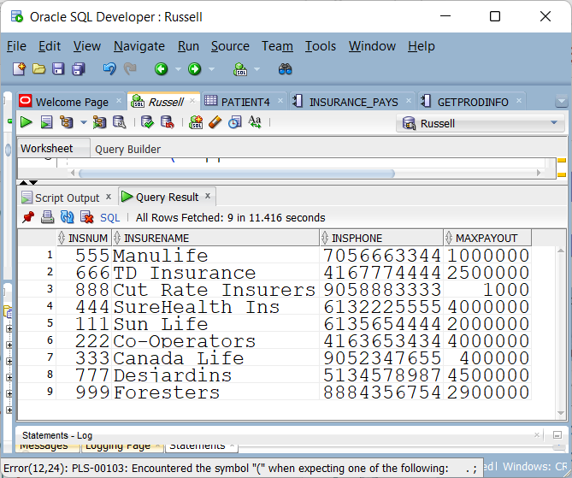
INSURANCE4

Slide 10
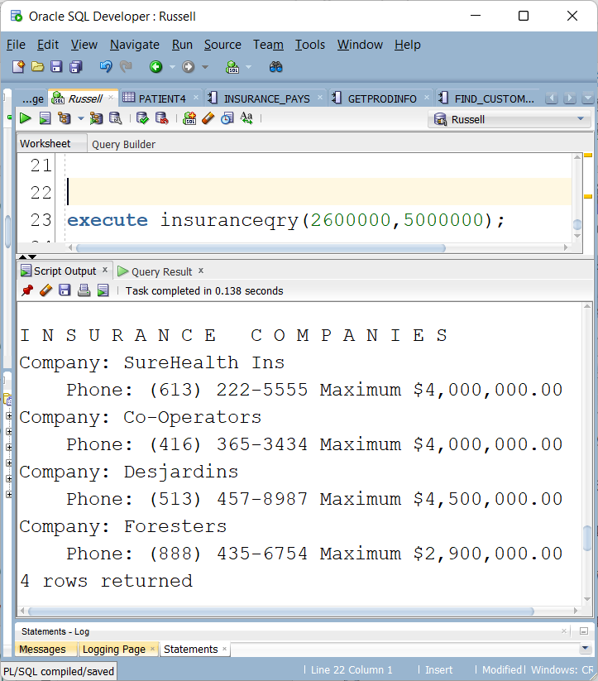
Explicit Cursors in an PL/SQL procedure Review exercise

Slide 11
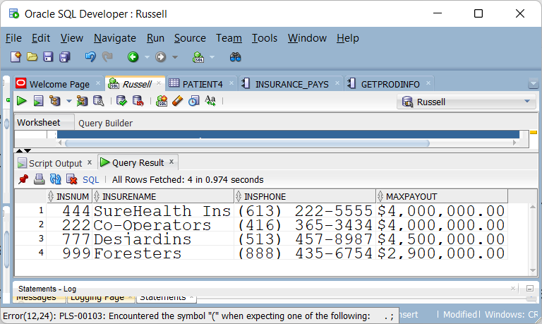
Range of 2,600,00 – 5,000,00
Formatting

Slide 12
Formatting & Range of 2,600,00 – 5,000,00
SELECT INSNUM,
INSURENAME,
'(' ||
substr(insphone, 1, 3) || ') ' ||
substr(insphone, 4, 3) || '-' ||
substr(insphone, 7) as insphone,
TO_CHAR(MAXPAYOUT, 'fmL9G999G999D00') MAXPAYOUT
FROM INSURANCE4
WHERE MAXPAYOUT BETWEEN 2600000 AND 5000000;

Slide 13
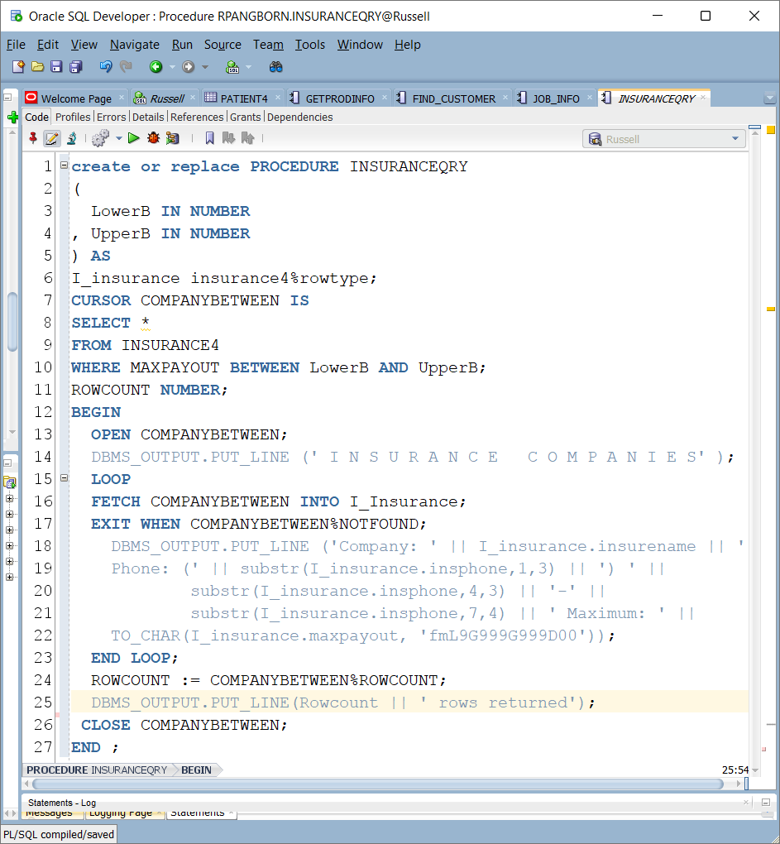
Solution

Slide 14
RAISE EXCEPTION
Lab 5 had the following result
EXECUTE INSPAYS2(666,70);
Insurance Co. TD Insurance 70% Rate Applied
3 Patient(s) updated
What if there was a law that insurance companies have to compensate a minimum of 25% of the claim
This has already been implemented as an exception in INSPAYS2
EXECUTE INSPAYS2(666,22)
Error report -
ORA-20001:
ORA-06512: at "RPANGBORN.INSPAYS2", line 12
ORA-06512: at line 1

Slide 15
RAISE EXCEPTION
This has also already been implemented as an exception in INSPAYS3
With more information in the error reporting
EXECUTE INSPAYS3(666,22)
Error report -
ORA-20001: Invalid Insurance Rate
ORA-06512: at "RPANGBORN.INSPAYS3", line 12
ORA-06512: at line 1
The RAISE statement stops normal execution of a PL/SQL block or subprogram and transfers control to an exception handler.

Slide 16
RAISE EXCEPTION
To define a user defined exception we include
invalid_rate EXCEPTION;
A user defined exception must have an assigned error code.
In this syntax, the error code is an integer that ranges from -20,999 to -20,000
PRAGMA exception_init( invalid_rate, -20001 );
The PRAGMA keyword is used to signify that the remainder of the PL/SQL statement is a pragma, or directive to the compiler.
Exception_init tells the compiler to associate a particular error number with an identifier you have declared as an exception in your program

Slide 17
RAISE EXCEPTION
To raise the exception and stop processing the update
BEGIN
If percentpay < 25 then
raise invalid_rate;
END IF;
create or replace PROCEDURE INSPAYS2
(
PINSURE IN NUMBER,
PERCENTPAY IN INTEGER
) AS
invalid_rate EXCEPTION;
PRAGMA exception_init( invalid_rate, -20001 );
namein CHAR (30);
rowsupdated number;
BEGIN
If percentpay < 25 then
raise invalid_rate;
END IF;

Slide 18
RAISE EXCEPTION
For INSPAYS3
We replace
raise invalid_rate; with
raise_application_error(-20001, 'Invalid Insurance Rate’);
Giving us:
Error report -
ORA-20001: Invalid Insurance Rate
ORA-06512: at "RPANGBORN.INSPAYS3", line 12
ORA-06512: at line 1
Instead of:
Error report -
ORA-20001:
ORA-06512: at "RPANGBORN.INSPAYS2", line 12

Slide 19
RAISE EXCEPTION
A more controlled error handling with INSPAYS2
EXECUTE INSPAYS2(666,22);
Invalid rate, must be 25% or higher
PL/SQL procedure successfully completed.
At the bottom of your block of code
DBMS_OUTPUT.PUT_LINE (ROWSUPDATED || ' Patient(s) updated’);
EXCEPTION
WHEN INVALID_RATE
THEN
DBMS_OUTPUT.PUT_LINE ('Invalid rate, must be 25% or higher');
END;

Slide 20
USER DEFINED FUNCTIONS
Created with PL/SQL or Java WITH ORACLE
Created with SQL/PL or RPGLE, C … programs with DB2
UDF’s can appear in an SQL statement
A UDF in a SELECT statement can be found:
in the select list
as the condition in a WHERE clause
in an ORDER BY clause
in a GROUP BY clause

Slide 21
USER DEFINED FUNCTIONS
UDF’s can appear in other SQL statements
A UDF in an INSERT statement can be found:
in the VALUES clause
A UDF in an UPDATE statement can be found:
in the SET clause
A PL/SQL function is a stored piece of code that can be called from other functions/procedures or programs. A function returns a value using the RETURN clause.

Slide 22
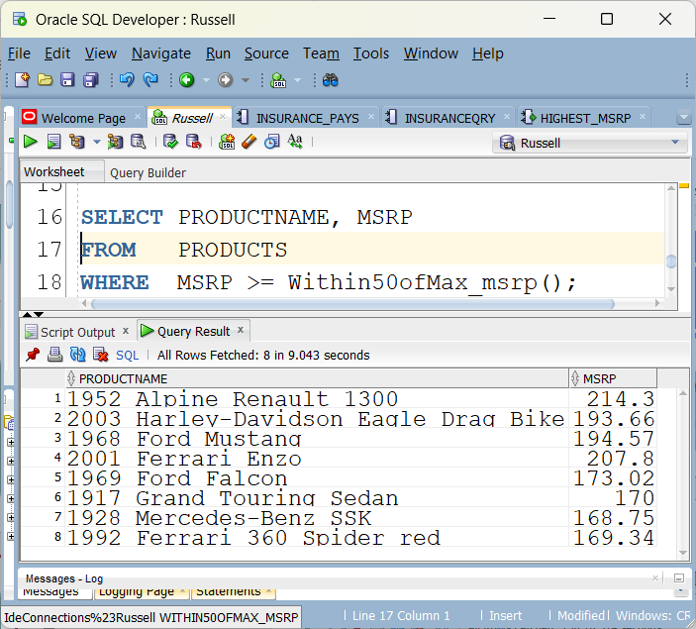
UDF in a SELECT STATEMENT

Slide 23
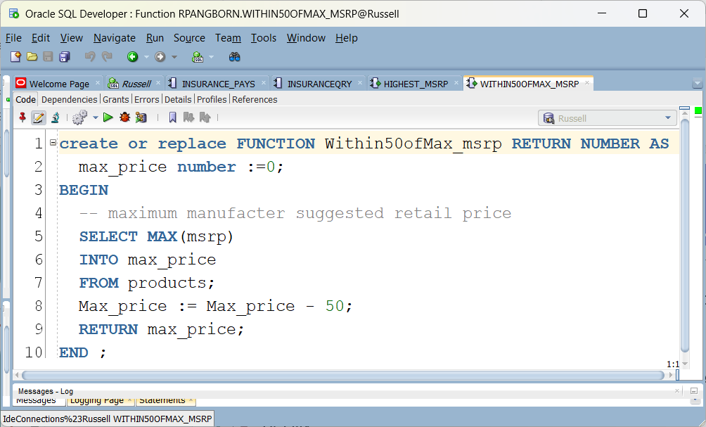
UDF in a SELECT STATEMENT
SELECT productname,msrp FROM products
WHERE msrp >= (SELECT MAX(msrp) – 50 FROM products);
We can replace the sub select with a UDF

Slide 24
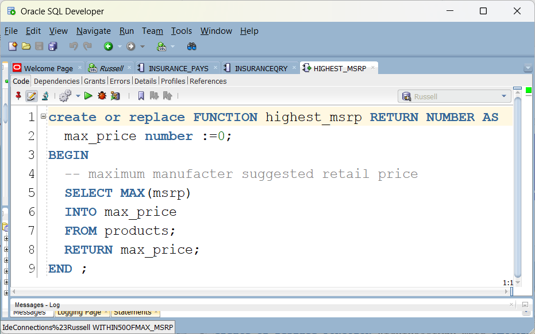
Highest_msrp

Slide 25
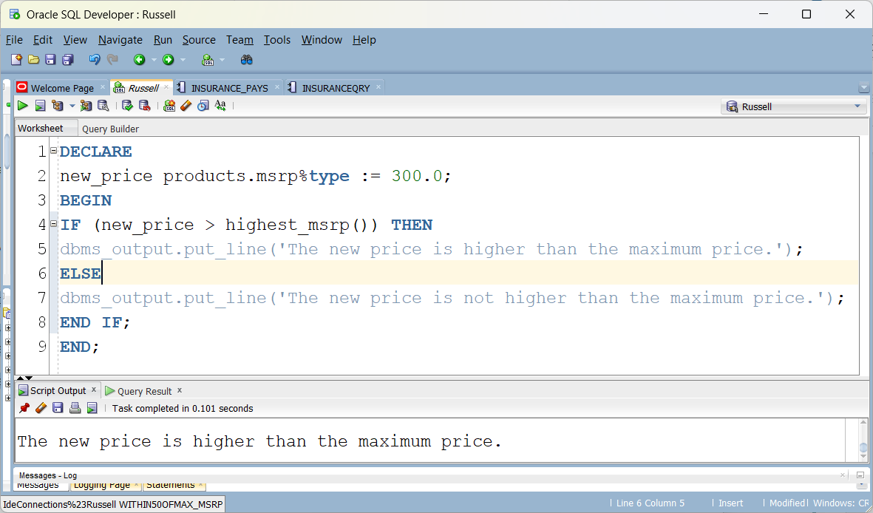
UDF in an anonymous block
The returning value of a function can be used in a conditional statement.
Results in: The new price is higher than the maximum price.

Slide 26
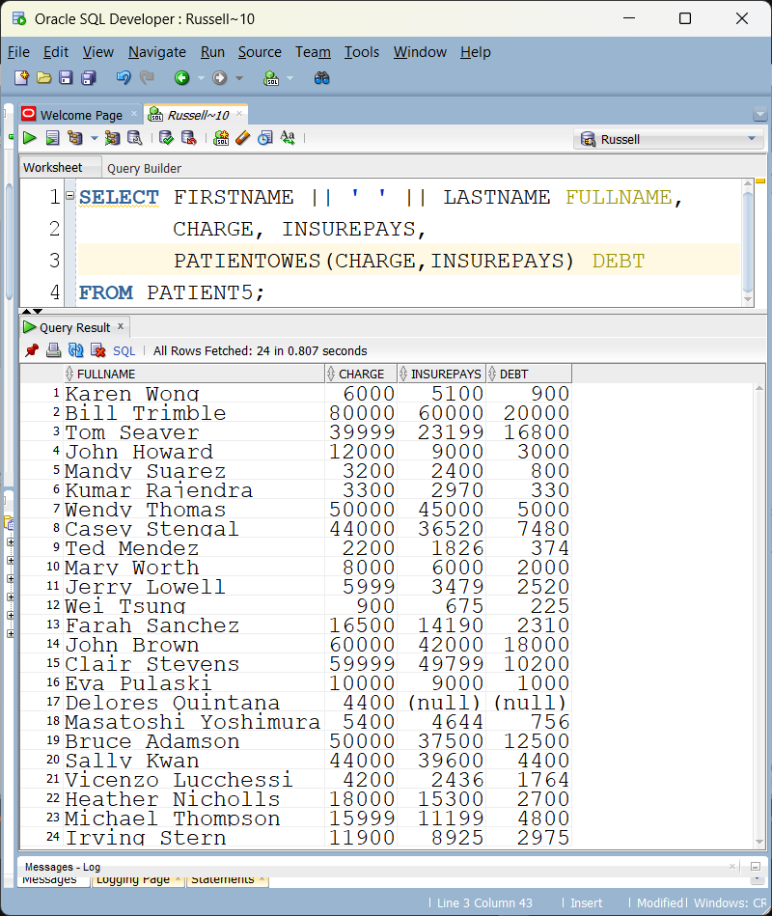
A UDF with two input parameters

Slide 27
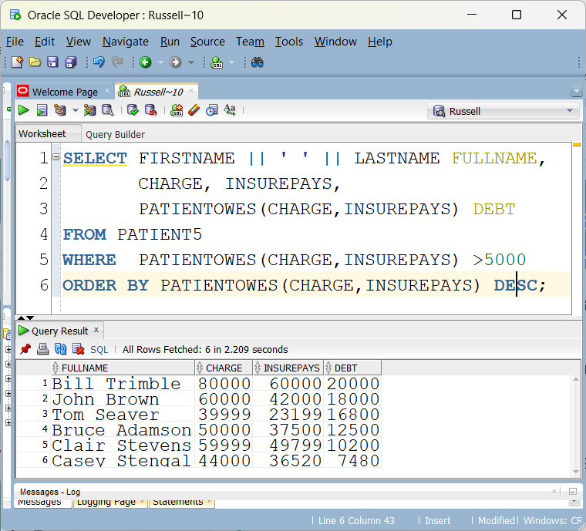
A UDF used in Select, Where and Order By
SELECT firstname || ' ' || lastname as fullname,
charge, insurepays,
PATIENTOWES(charge,insurepays) as debt
FROM patient5
WHERE PATIENTOWES(charge,insurepays) > 5000
ORDER BY PATIENTOWES(charge,insurepays) desc;

Slide 28
A UDF with two input parameters
create or replace FUNCTION PATIENTOWES
(
CHARGE IN NUMBER,
INSUREPAYS IN NUMBER
)
RETURN NUMBER AS
AMOUNTOWED NUMBER;
BEGIN
AMOUNTOWED := CHARGE - INSUREPAYS;
RETURN(AMOUNTOWED);
END;

Slide 29
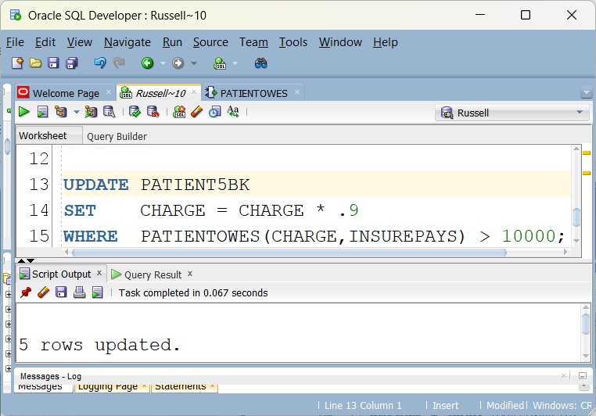
UDF in an UPDATE STATEMENT
After the insurance decision, some patients still owe a lot of money. A decision may be made to lighten the burden for some patients at a certain threshold.
If their debt exceeds 10,000 it is reduced by 10%
create table patient5bk as (select * from patient5);

Slide 30
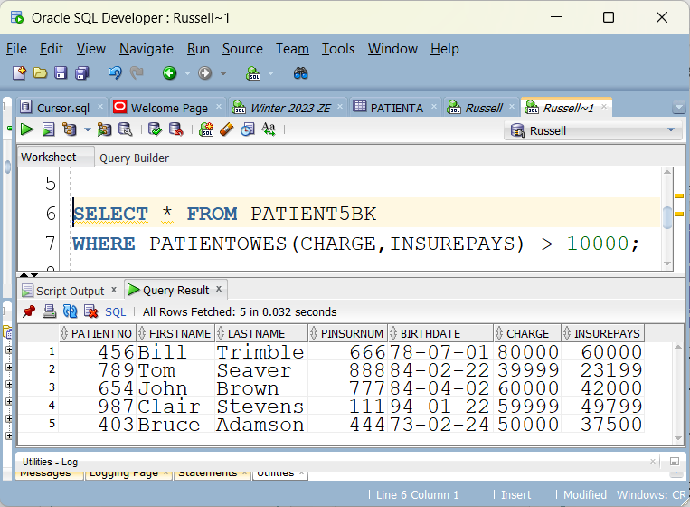
DROP TABLE PATIENT5BK;
CREATE TABLE PATIENT5BK AS
(SELECT * FROM PATIENT5);
SELECT * FROM PATIENT5BK
WHERE PATIENTOWES(CHARGE,INSUREPAYS) > 10000;

Slide 31
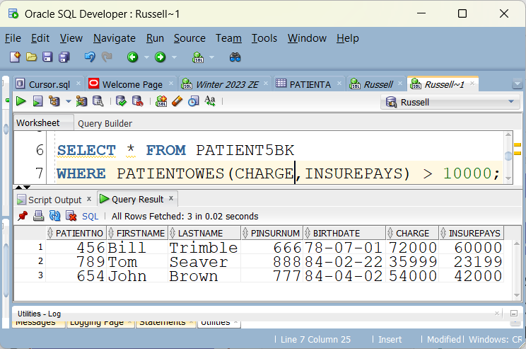
UPDATE PATIENT5BK
SET CHARGE = CHARGE * .9
WHERE PATIENTOWES(CHARGE,INSUREPAYS) > 10000;

Slide 32
Triggers
A trigger is a named PL/SQL block stored in the Oracle Database and executed automatically when a triggering event takes place.
A DML statement executed against a table can cause the trigger to fire
A trigger can be set to fire before or after an Update, Insert or Delete and is applied to a table depending what is considered needed for the situation.
Uses for a Trigger
for a startup or shutdown of the Oracle Database
for a user event like a log in or log out.
Some situations where business rules are more complex then the
traditional constraints of Unique, Not Null and Check.
to prevent an invalid transaction
to Gather statistical information on table access
to Audit sensitive data

Slide 33
How to Create a Trigger in Oracle
CREATE [OR REPLACE] TRIGGER trigger_name
{BEFORE | AFTER} triggering_event ON table_name
[FOR EACH ROW]
[FOLLOWS | PRECEDES another_trigger]
[ENABLE / DISABLE]
[WHEN condition]
DECLARE
declaration_statement
BEGIN
executable statements
EXCEPTION
exeption_handling statements
END;

Slide 34
Table to store trigger events
CREATE TABLE AUDITS (
audit_id NUMBER GENERATED BY DEFAULT AS IDENTITY PRIMARY KEY,
table_name VARCHAR2(255),
transaction_name VARCHAR2(10),
by_user VARCHAR2(30),
transaction_date DATE
);

Slide 35
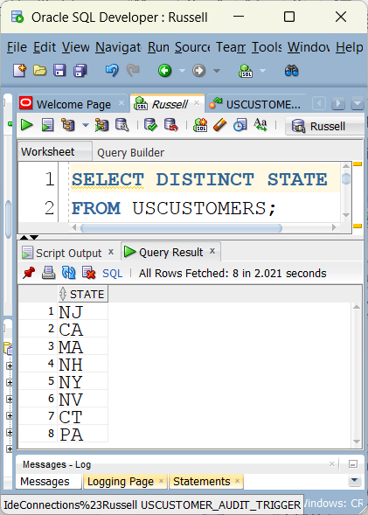
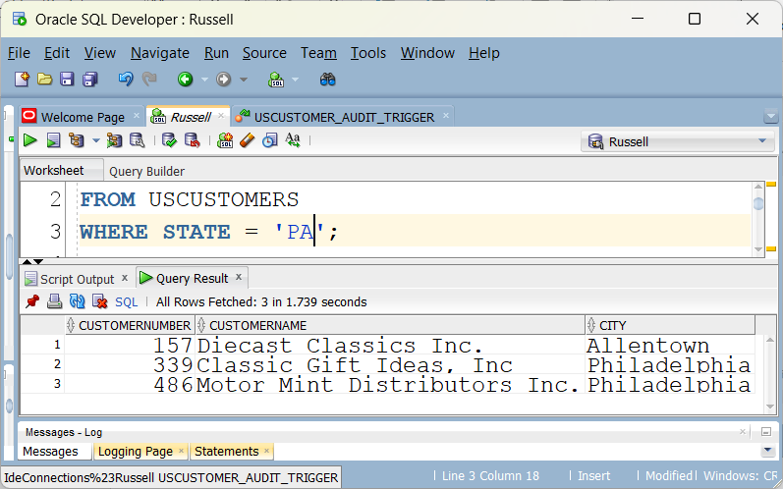

Slide 36
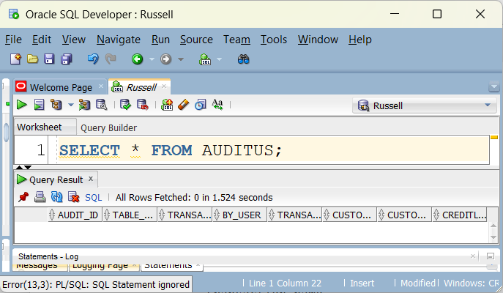
USCUSTOMER TRIGGER
A trigger is set up to make entries in an audit table for Updates or Deletes to the USCUSTOMER table
It is currently empty

Slide 37
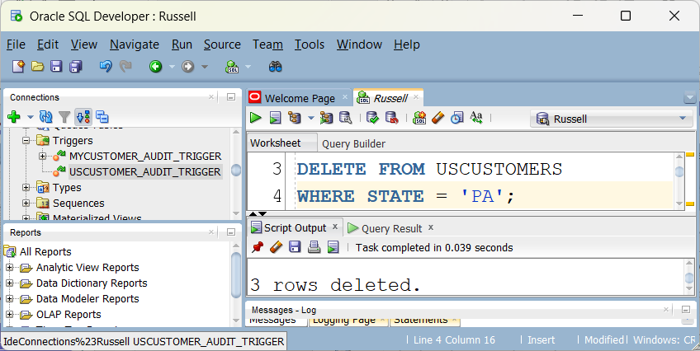
The trigger fires when rows are deleted from the USCUSTOMER table

Slide 38
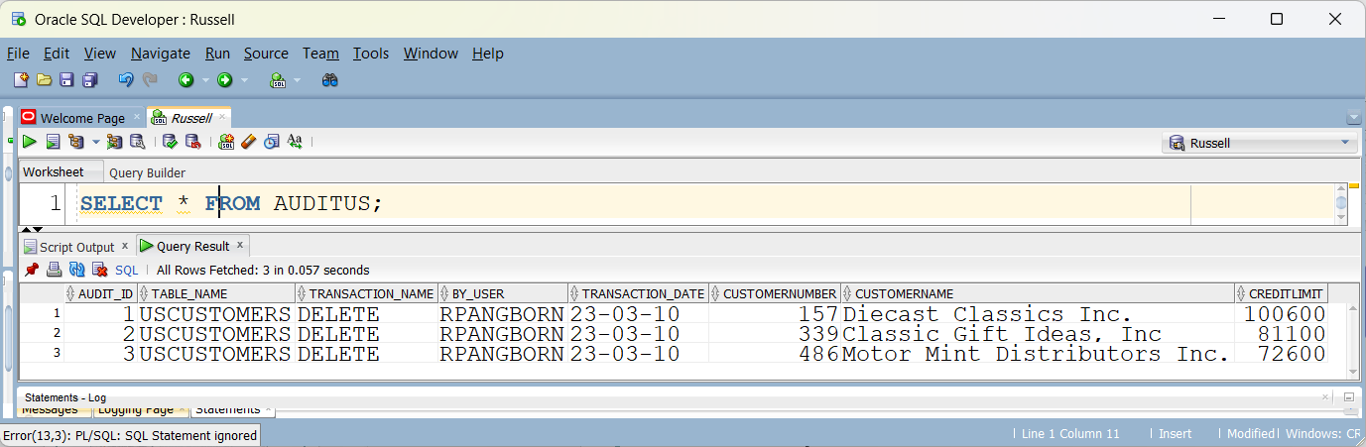
The audit table reflects the deletions that occurred

Slide 39
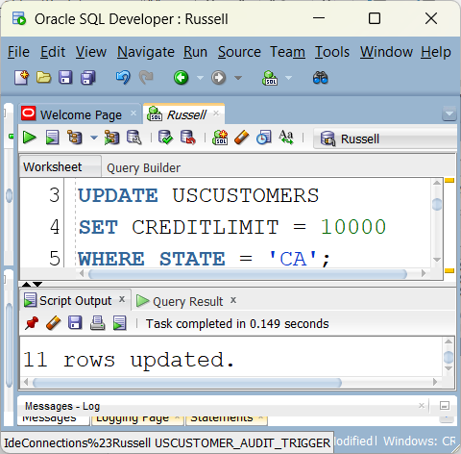
An update will also cause the trigger to fire

Slide 40
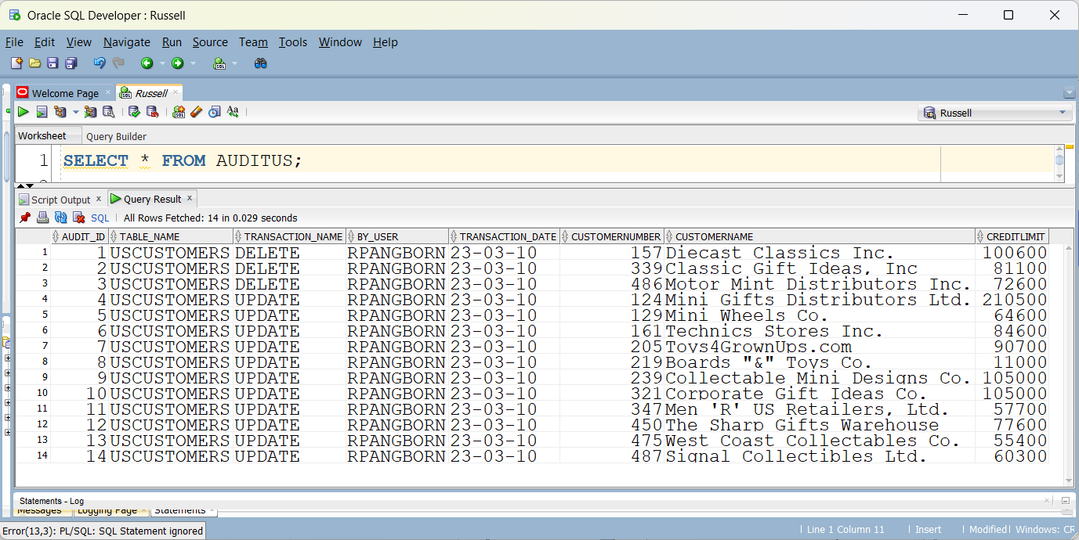
More entries are inserted into the audit table after the update

Slide 41
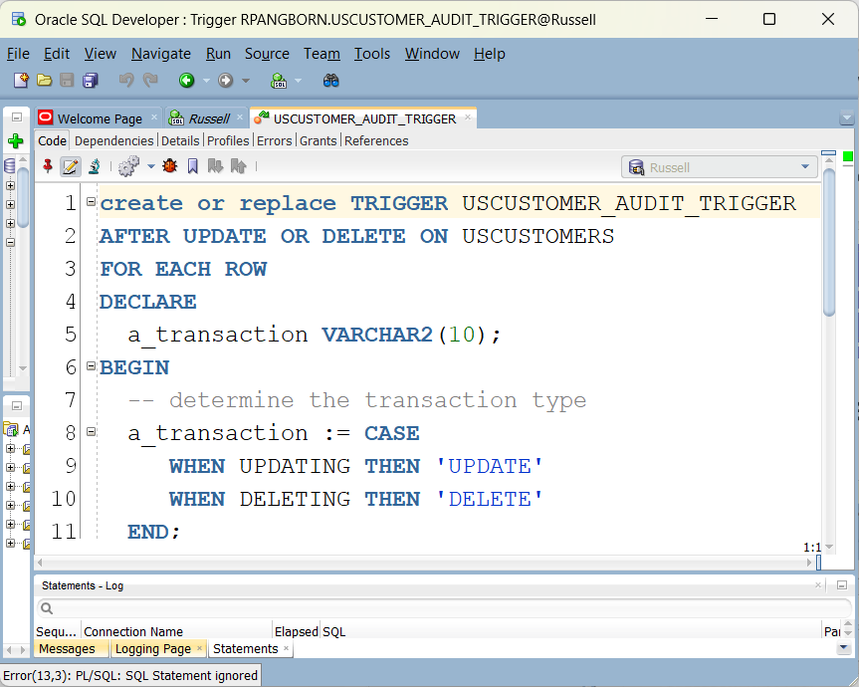
The Trigger

Slide 42
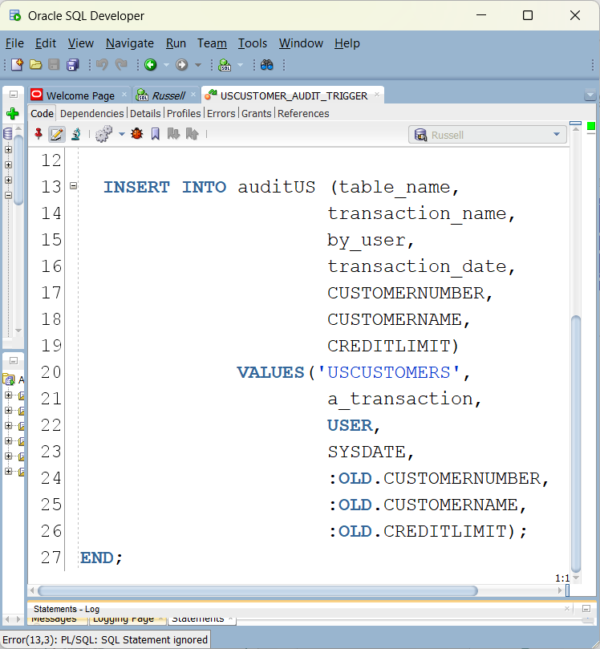
The Trigger (continued)

Slide 43
Trigger OLD vs NEW
INSERT- :old.value= NULL, :new.value= post insert value
DELETE- :old.value= Pre Delete value, :new.value= null
UPDATE- :old.value= Pre update value, :new.value= Post Update value

Slide 44
Assignment 2
Assignment 2 has been posted

